Slide 1

Chiemeka Okeoma
Data Scientist
Introduction:
Maryland Native
University of Maryland, Baltimore County, Statistics B.S (Dec 2020)
4 years experience in data science roles on DoD and IC projects
Current Data Scientist at Deloitte, exploring new opportunities
Contact Information:
ohpzson@gmail.com
240-252-8991

Slide 2
Inspiration/Research Question
Counter-strike enjoyer of 11 years
Once reached “global elite” matchmaking rank (top 1% of players)
Research Question:
Can we effectively predict what team will win a round based on a snapshot containing round info?
And what factors are most important in determining this?

Slide 3
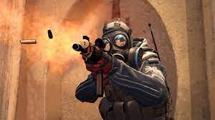
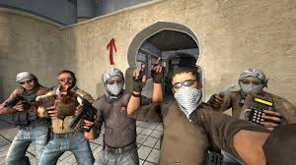
What is counter strike?
Counter-Strike Global Offensive is a 5v5 first person shooter pitting offense (T’s) against defense (CT’s) in 15 round halves. The first team to 16 round wins, wins the game. There is a maximum of 15 rounds played in half. Teams switch sides at the end of the half.
Offense win condition: Eliminate all 5 defensive players OR plant the bomb at one of two bombsites and defend it until it explodes
Defense win condition: Eliminate all 5 offensive players before bomb is planted OR have at least one player survive until the round timer expires OR defusing the bomb, assuming it is planted

Slide 4
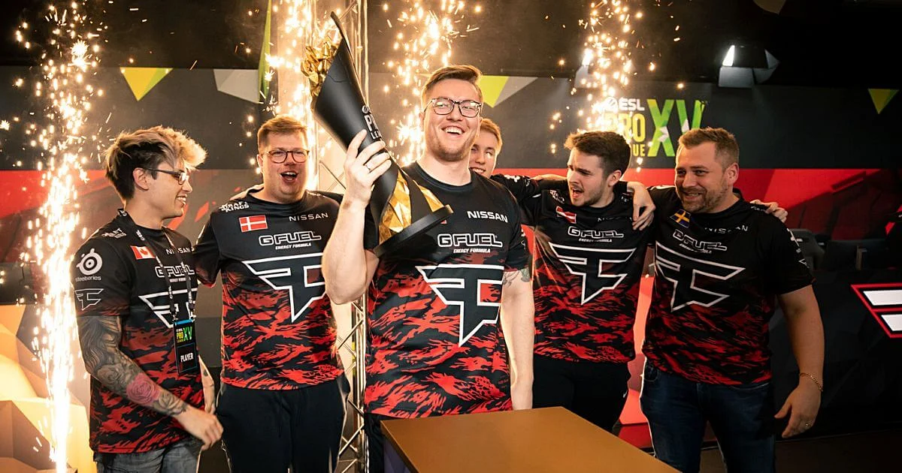
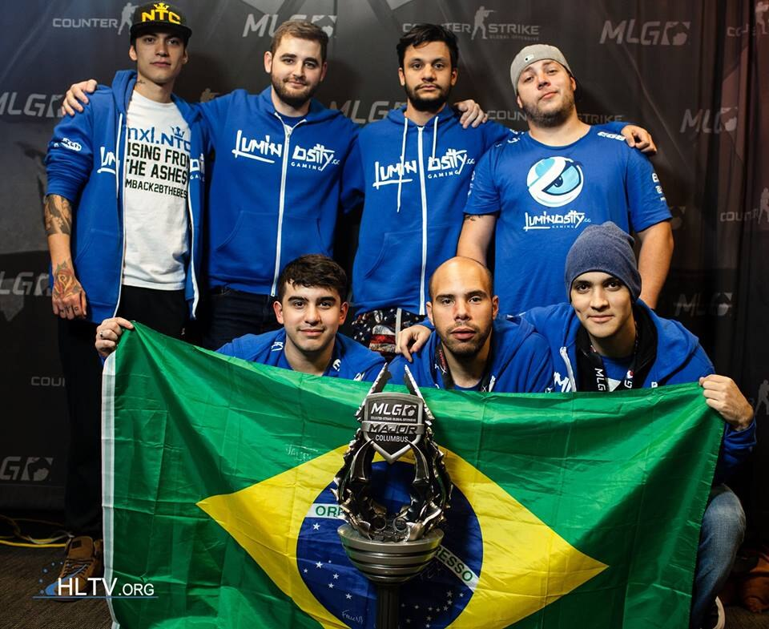
What’s at stake?
Players play for prestige millions dollars in prize money every year as well as prestige
Having a means to make informed decisions in game that could help lead to victory would be of value

Slide 5
The Data
Data: Skybox Technologies CSGO Round Snapshots(2020)
Release Date: Initially released in July 2020
Data description: The data set consists of ~700 demos from high level tournament play in 2019 and 2020. Warmup rounds and restarts have been filtered, and for the remaining live rounds a round snapshot have been recorded every 20 seconds until the round is decided.
Link: https://www.kaggle.com/datasets/christianlillelund/csgo-round-winner-classification

Slide 6
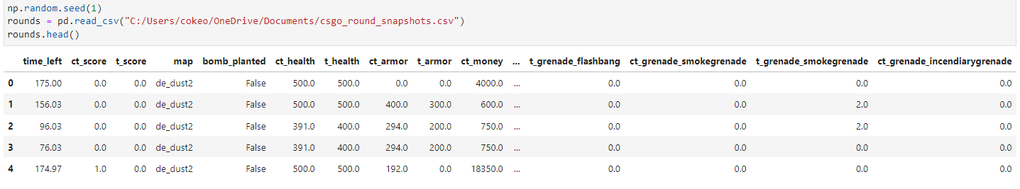

Exploratory Data Analysis (EDA)
Data set properties at first glance:
122410 Rounds
97 variables
Info on weapons and utility is recorded as well as other miscellaneous information is recorded

Slide 7
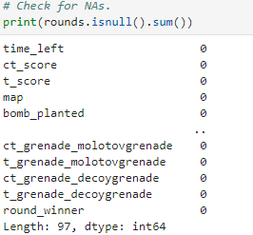
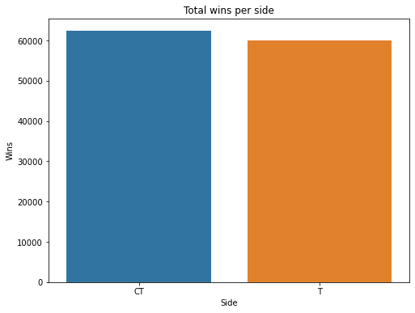
EDA continued
Round wins per side are relatively balanced
No null values in data set

Slide 8
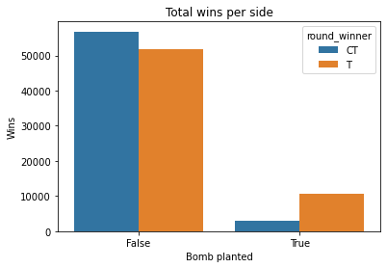
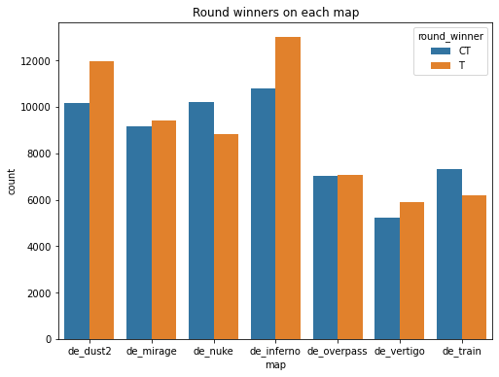
EDA continued
T’s can pick up more round wins if they can get the bomb planted
This makes sense as when the bomb is planted T’s have most likely already eliminated some CT players.
Some maps such as Nuke, Train, and Dust2 have historically had a side advantage.

Slide 9
Model Selection
Classification Models | Description
Logistic Regression | Used to model the probability of a certain class or event occurring
K-Nearest Neighbors | Takes multiple labeled points and uses them to learn how to label other points
Decision Trees | Uses a tree-like graph or model of decisions and their possible consequences to classify data
Random Forest Classifier | An ensemble method that builds multiple decision trees and aggregates the results. This limits overfitting and bias error.
Gradient Boosted Model (GBM) Classifier | An ensemble method that makes new predictors from the mistakes of previous predictors.
Data has been preprocessed after publication making it easier for algorithms to process.
Converted target to 0’s and 1’s so it could be ingested by classification models
Scaled data where necessary

Slide 10
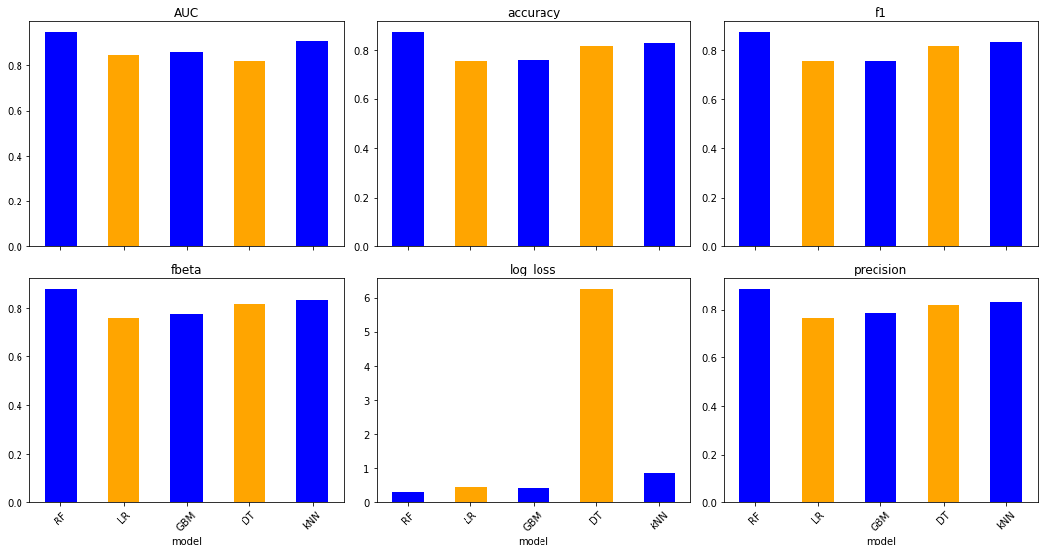
Model selection Continued

Slide 11
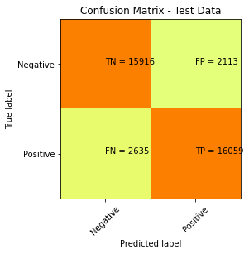
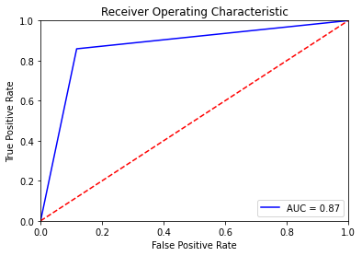
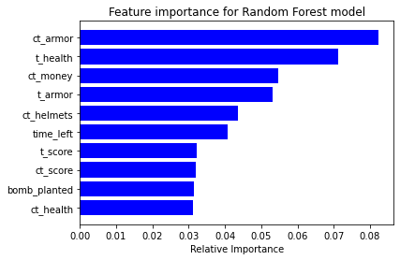
Model Champion
Model champion: Random forest
Accuracy: 87.07%
True positives: T-side round wins
True negatives: CT-side round wins

Slide 12
In-game application
If applied to a specific team, coaches and analysts could use this model to gauge how likely the team will win in certain scenarios.
There is an economy system in the game. Players must manage their money and decide when to buy weapons and utility, or to save money for the next round, based on what they think their chances of winning are.
There are scenarios where it is unclear what decision the team should make: whether to buy in a round or save money or whether to attempt to retake a bombsite and save weapons for the next round.

Slide 13
Limitations/future work
Data considerations:
Expanding the data to know which player has what weapons and utility when the snapshot was taken
Would likely have to be snapshots taken for a specific team
Limitations:
Model does not account for players performance within the game.

